Slide 1
Introduction
Due to the high turnaround of educators in small and medium learning centers, the total process takes a lot of time. iLearnCentral helps solve this predicament. It is a mobile application that helps ease the whole experience of learning centers from hiring and profiling of educators to scheduling and enrollment.

Slide 2


Slide 3
iLearnCentral: A Cloud-Based Learning Center Platform with Mobile Technology
A Capstone Project
by
Jephunneh C. Mabini |  | Rhea Shane M. Chiong |  | Cristian G. Paragoso
Project Manager |  | System Analyst/Database Designer, Software Engineer |  | Network/UI Designer, Technical Writer

Slide 4
Objective of the Study
The study aims to develop a cloud-based learning center platform with mobile technology for administrative staff, educators, parents, and students.
To achieve this aim, the specific objectives are:
to gather data on the issues encountered by small and medium learning centers;
to design features on the app for both educators and learning centers; and
to define software requirements for both web and mobile development.

Slide 5
Scope of the Study
Development is focused on learning centers and educators within Philippines
Pre-defined features
Profiling and Scheduling intelligence
Enrollment system
Supports Android version 5.0 and above
Web app is designed to run on Mozilla Firefox, Google Chrome, Microsoft Edge, and Safari
Internet connection

Slide 6
Limitations of the Study
Do not have company-specific feature
Cannot help the hiring of other staff members of learning centers
Mobile app functionalities are limited offline

Slide 7
Significance of the Study
Learning Center
Educators (applicants and employees)
Parents
Students
Researchers
Future Researchers

Slide 8
Related Literature
“e-Skwela: Community-based E-learning Centers for Out-of-School Youth and Adults, Philippines”. In Search of Innovative ICT in Education Practices: Case Studies from the Asia-Pacific Region.
Professional Development in Early Childhood Programs: Process Issues and Research Needs, Early Education and Development

Slide 9
Related Literature cont’d
“Introduction: The context for critical issues in early childhood professional development.”. In Critical issues in early childhood professional development
“Improving connections between professional development research and early childhood policies.”. In Critical issues in early childhood professional development..
The Use of an Automated Employment Recruiting and Screening System for Temporary Professional Employees: A Case Study. Human Resource Management.
“New technology-based recruitment methods” Research Gate. Retrieved September 30, 2019, from https://www.researchgate.net/publication

Slide 10
Comparative Matrix
Related Studies | Features | Limitations | Platform Details
Name: Eryl URL: None Year: July 2018 | - allows users to become students and tutors - allows to negotiate on a teacher pool | - not fully released | - None
Name: OrangeApps URL: https://orangeapps.ph/ Year: 2014 Proponents: Gian Javelona | - admin, reacher, student and parents monitoring and management system | -intended for huge schools and universities | - Web, Android, iOS
Name: Schoology URL: https://www.schoology.com/ Year: 2009 Proponents: | - for K-12 school and higher education institutions - automated grading system - calendars and messaging | - educator-centric app | - Web, Android, iOS
Name: iEduCentre URL: https://www.ieducentre.com/ Year: 2011 | - CRM & scheduling - attendance tracking, fee automation - student, parent and portals human resource & payroll | - only available in the US | - Web
Name: SpellWizards URL: https://spellwizards.co.uk/ Year: Unknown | - spelling assistant for children aged 4 to 11 | - only for learning to spell | - Web
The comparative matrix shows the different studies that are related to the proposal.

Slide 11
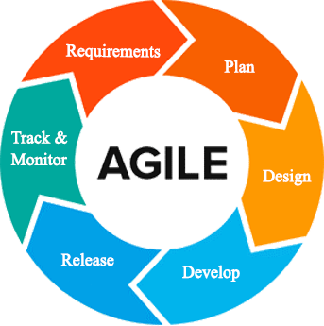
Agile Development Methodology
One of the benefits of the agile approach that suits this study is collaboration and open interactions with designers, advisers, and collaborators based on their feedback and any changes that occur throughout the development. It promotes flexible planning, structural growth, first conveyance, ongoing transition, and facilitates rapid and adaptable response to change.

Slide 12
Requirement Analysis Phase
Initially, the team members make the primary manuscript and background researches on learning centers, educators, and job-seekers to lay out the things to do. In every iteration, the team members assigned to work on the obstacles, analyze the issues and come up with a possible solution. They consult on resolutions with the other members. At the end of each day, the team members report on their progress.
Plan Phase
The team determines schedules, preparations, and plans of actions to handle changes during the iteration. In every sprint cycle, the organizations made are directed towards the fulfillment of its intentions. Itemized priorities and time constraints are the focus of budget allocation by the project manager. The team establishes communication routes for questions and issues that may arise.
Design Phase
The specifications evaluated and defined by the designers are used in the design phase to make design choices using various diagrams. The UI designer assigned creates the user interface. The programmer and database designer must describe the device element interface mechanism. The project manager monitors the progress of the members' tasks. From the selected sprint backlog, the team determines which designs to tackle from the manuscript. There is a parallel development of mobile and web applications.
Development Phase
The developers check the software, analyze it, and identify the issues and update or modify it beyond the steps or requirements that were set up. Until deployment, all parts of the operation underwent a continuum of individual evaluation through different testing methods to ensure its efficacy and efficiency.
Release
Before releasing it to the market, developers carried out several activities to test the application. It allows the system to work within each operation of the deployment phase with tolerable performance and specific processes. Using the guidance given in the deployment document, developers then installed the application in the server environment.
Track and Monitor
Another sprint cycle happens at the end of the previous. A sprint review with all members determines the set of activities for the next iteration. It includes adjustments from leftover unfinished tasks, additional features requested, and feedback from monitoring.

Slide 13
Business Model Canvas
Key Partners | Key Activities | Value Proposition |  | Relationships | Customer Segment
-Learning centers administration -Educators currently teaching in learning centers -Job seeking educators | -Design and develop an intelligent school management software geared towards the needs of learning centers, educators, students | - System can be used by any type of learning center - System could automate basic operations of administration with integrated artificial intelligence - System has additionalsupport to the educators and students |  | - Customer service hotlines - User Feedback - Email | - Learning center administration - Educators in learning centers - Students in learning centers - Educators seeking employment
 | Key Resources |  |  | Channels
 | - Web domain and host - Developers - UI/UX designers - Researchers |  |  | - On-location Visits - Company Website - Social Media Marketing - Word of mouth
Cost Structures |  |  | Revenue Streams
- Customer acquisition costs - Research and Development - Marketing and Advertising - Hosting, Operations and Maintenance |  |  | - Subsciption based on feature packages - Ad Revenue from free or trial users

Slide 14
Program Workflow
User Activity Program Workflow

Slide 15
Hiring Module Program Workflow

Slide 16
Enrolment Module Program Workflow

Slide 17
Scheduling Module Program Workflow

Slide 18
Teaching Assistance Program Workflow

Slide 19
Validation Board
Experiments | 1 | 2 | 3
Customer | Learning Center Administration | Employed Educator | Job-Seeking Educators
Problem | Learning centers using manual transactions to support common management processes i.e. hiring, enrolment, and scheduling | Variation of lessons for different students handled, maintaining schedules, and keeping records | High turnover of educators in learning centers leading to constant demand amidst particular qualifications.
Solution | A dynamic learning center management system supporting different types of learning centers, i.e. day care, music, language studies | Adding a module for educators employed by a center to keep track of lessons, update schedules, and integrate records to the system. | Data pool of job-seeking educators sifted and recommended to fit learning centers' particular needs and vice versa.
Riskiest Assumption | Learning Center have no IT support | Learning center provide resources i.e. internet connectivity to employees | Educators uses the system to look for employment in learning centers
Method and Success Criteria | 60% of the respondents agree to use the system | 60% of the respondents agree to use the system | 60% of the respondents agree to use the system
The table shows the different problems that our customers encountered. It also shows the solution to the problem being solved by the researcher. Table 3 also contains the most risky assumption, the methods and the criteria for success, the results and the decision, as well as the learning.

Slide 20
Gantt Chart
Task ID | Task Name | Task Lead | Start Date | End Date | August 2015 |  |  |  | September 2015 |  |  |  | October 2015
 |  |  |  |  | 1 | 2 | 3 | 4 | 1 | 2 | 3 | 4 | 1 | 2 | 3 | 4
1 | Title Consultation |  | Aug 16 | Sep 16
2 | Project Proposal recommended |  | Sep 16 | Sep 16
3 | Discussion with adviser | Jephunneh | Sep 19 | Sep 23
4 | Preliminary research of the project | Cristian | Sep 23 | Sep 26
5 | Writing and Compiling of Initial and Final Pages | Jephunneh | Sep 23 | Oct 26
6 | Writing of Chapter 1 | Cristian | Sep 23 | Sep 26
7 | Consultation with adviser on Chapter 1 | Jephunneh | Sep 27 | Sep 27
8 | Preparing of Transmittal Letter/s | Rhea Shane | Sep 16 | Sep 23
9 | Preparing of Questionnaires | Rhea Shane | Sep 16 | Sep 23
10 | Interviews/Surveys | Rhea Shane | Sep 23 | Oct 11
11 | Finalizing of Chapter 1 | Cristian | Sep 27 | Sep 28
12 | Writing of Chapter 2 | Cristian | Sep 29 | Oct 2
13 | Consultation with adviser on Chapters 1 and 2 | Jephunneh | Oct 2 | Oct 2
14 | Finalizing of Chapter 2 | Cristian | Oct 2 | Oct 4
15 | Designing User Interfaces | Cristian | Oct 7 | Oct 17
16 | Writing of Chapter 3 | Rhea Shane | Oct 7 | Oct 17
17 | Consultation with adviser on Chapters 1, 2, and 3 | Jephunneh | Oct 18 | Oct 18
19 | Consultation with Technical Editor | Rhea Shane | Oct 22 | Oct 25
20 | Finalizing of Chapter 3 | Rhea Shane | Oct 24 | Oct 26
21 | Concept Video & Presentation preparation | Jephunneh | Oct 21 | Oct 30
22 | Final consultation with adviser | Jephunneh | Oct 24 | Oct 25
23 | Compiling and finalizing of Manuscript | Rhea Shane | Oct 24 | Oct 26
24 | Poster design & preparation | Cristian | Oct 17 | Oct 20
25 | Proposal presentation

Slide 21
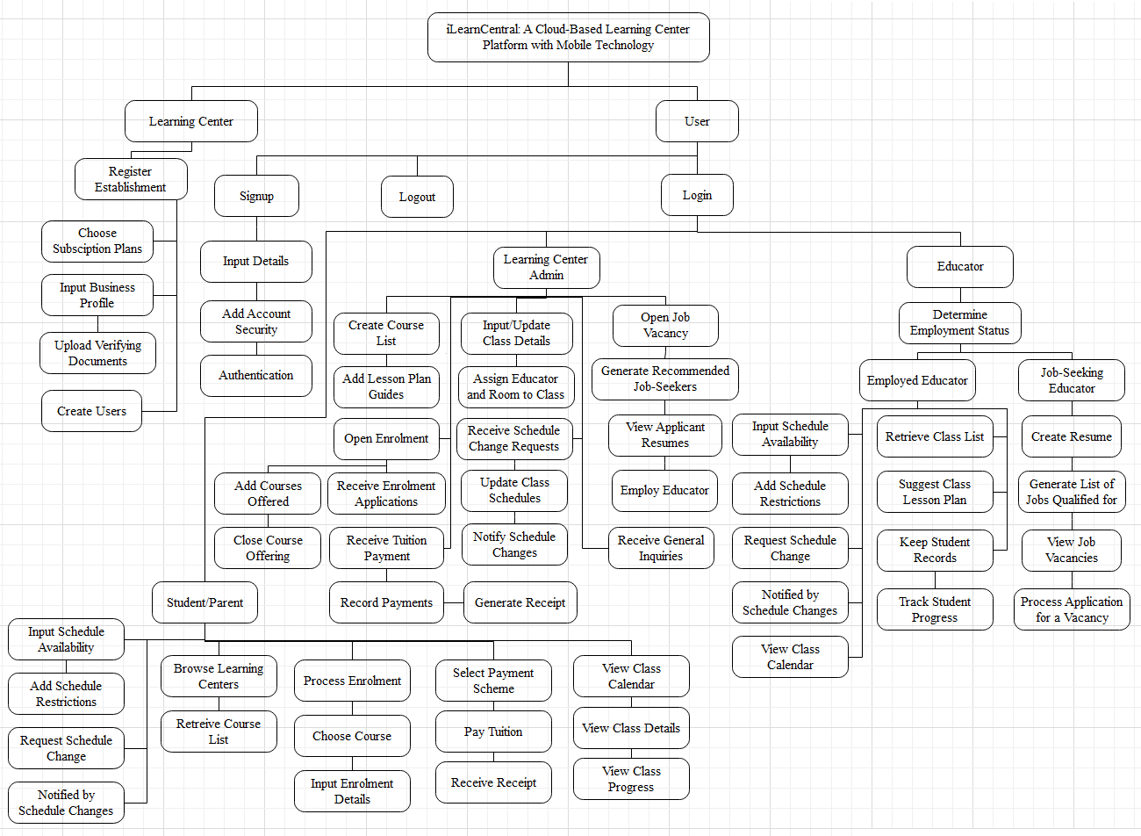
Functional Decomposition Diagram
The functional decomposition diagram demonstrates the operative relationship between the various components of the project into critical modules to clearly illustrate and simplify various activities.

Slide 22
Use Case Diagram
The diagram shows the graphic representation of the mechanism of iLearnCentral and potential sequences of interactions between systems and users in a specific environment related to a specific target.

Slide 23
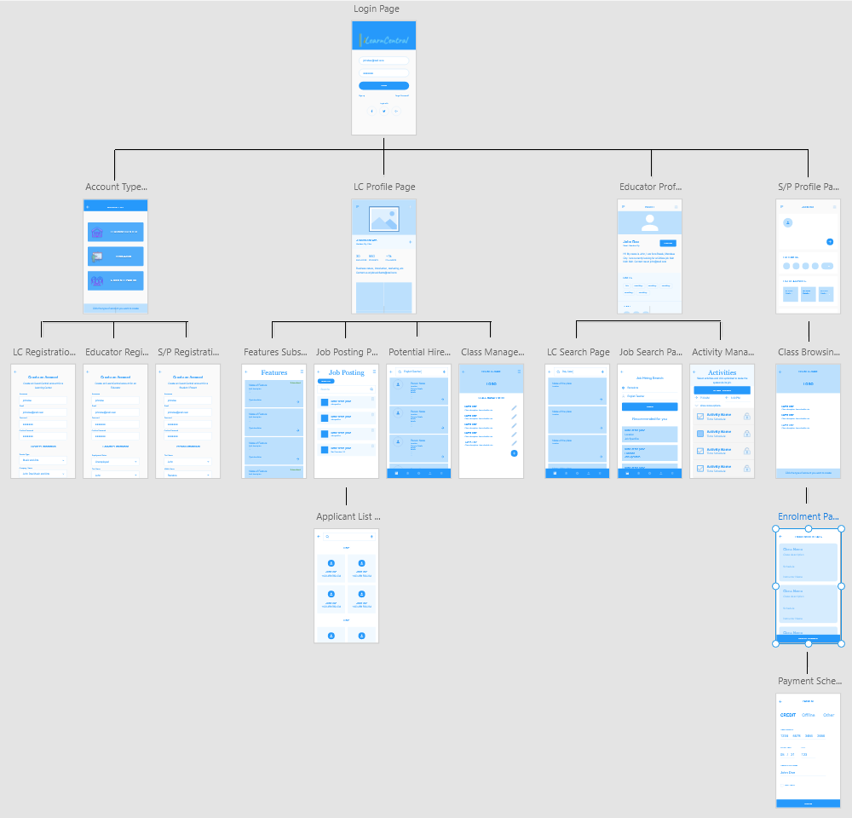
Partial Storyboard
This shows the graphical representation of the usage of the app.

Slide 24
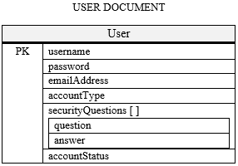
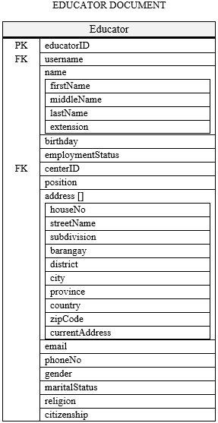
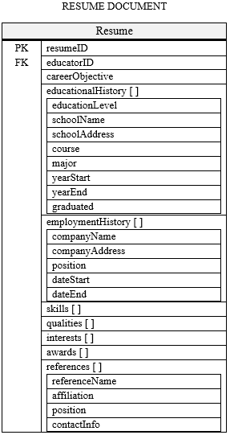
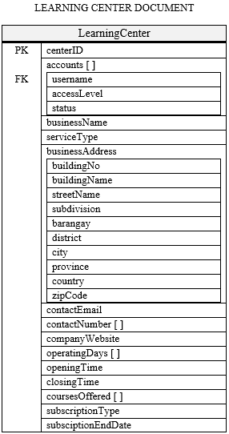
NoSQL
NoSQL has advantages with data volume, velocity, and variety. It allows for better adaptability to changes in schema when using agile development. It is scalable and accessible to multitudes of users, which is necessary to a cloud-based system.

Slide 25
Entity Relationship Diagram (ERD)
This figure shows the entity-relationship diagram of iLearnCentral's database.

Slide 26
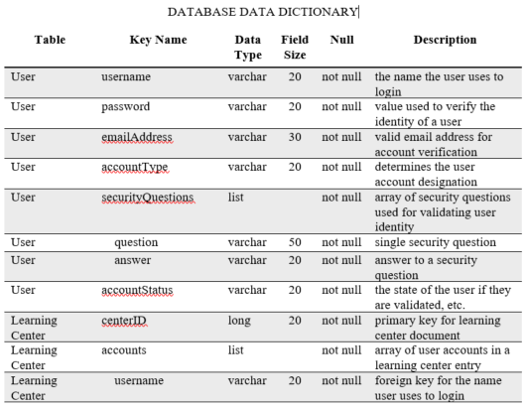
Database Data Dictionary
This contains the description for each detail in the records.

Slide 27
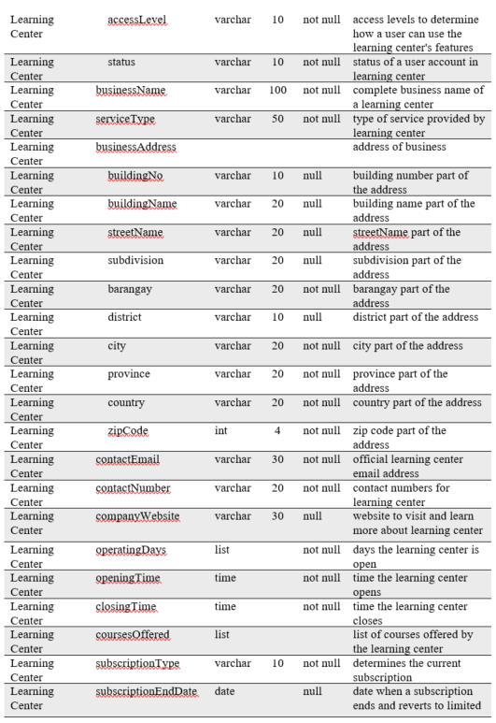
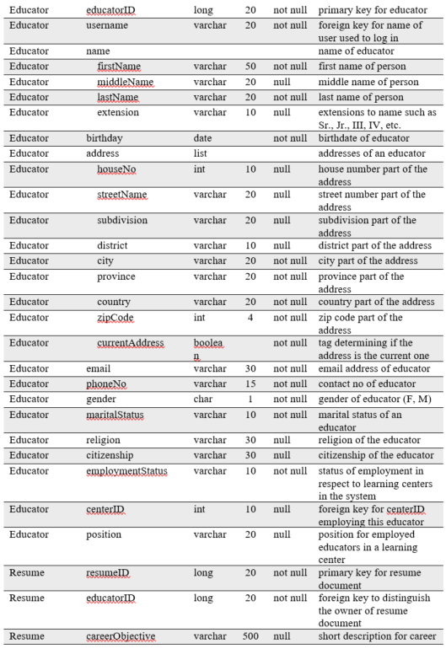
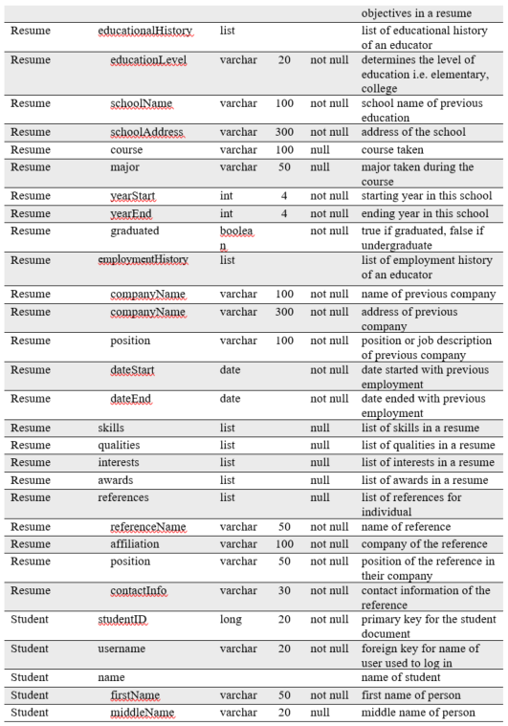

Slide 28
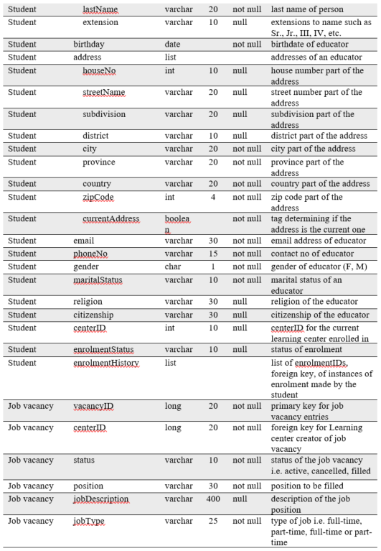
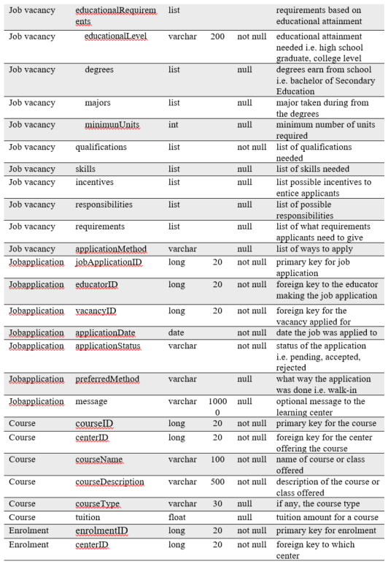
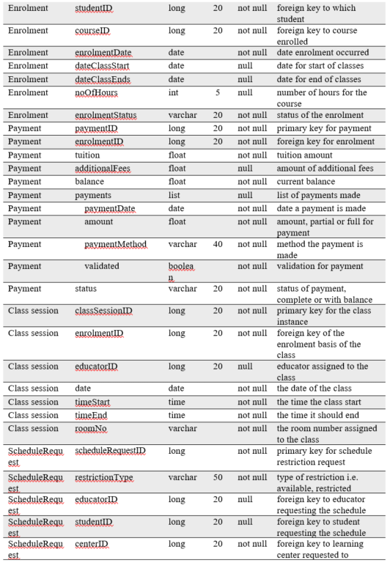

Slide 29
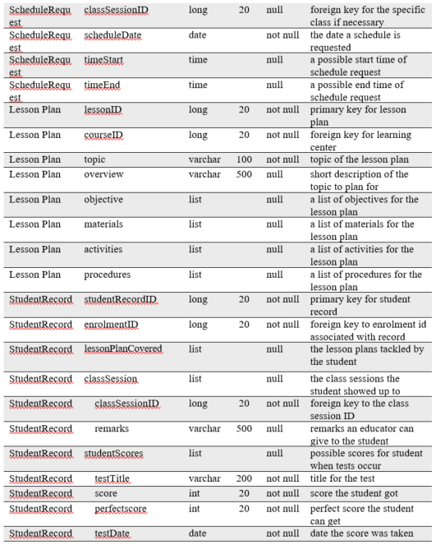

Slide 30
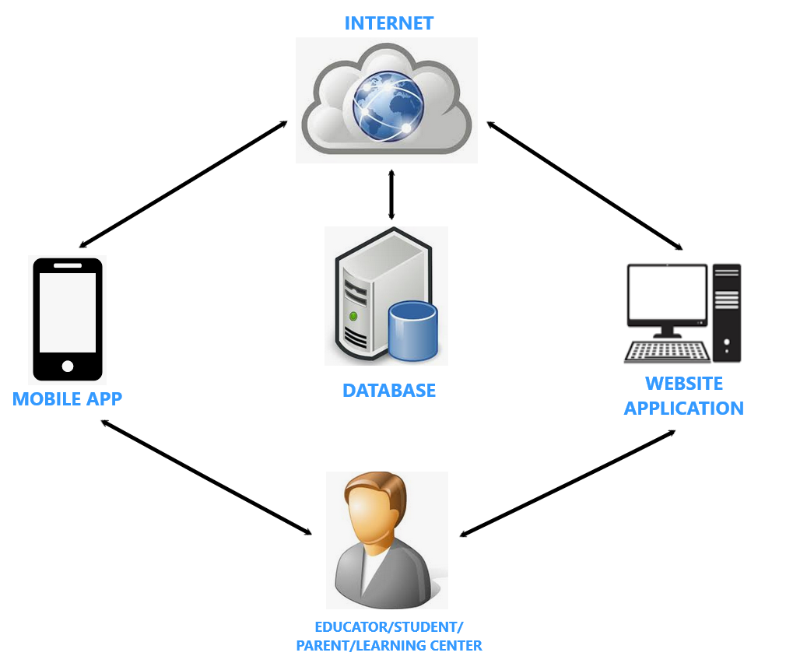
Network Topology
The network topology illustrates how the system's component work in conjunction with the use of internet connection to access the user's access database.

Slide 31
Technology Stack Diagram
This figure shows the technology stack diagram representing the different technologies the project uses and the purpose for each specific language.

Slide 32
Software List of Modules
Programmer/s | Modules | Learning Center | Educator | Parent or Student
Jephunneh Rhea Shane Cristian | Account Management
 | 1. Registration | * | * | *
 | 2. Authentication | * | * | *
 | 3. Login | * | * | *
 | 4. Profiling | * | *
No. of Points (1 point per module per user) |  | 1 | 1 | 1
Jephunneh Rhea Shane Cristian | Hiring Module
 | 1. Hiring Profile/Resume |  | *
 | 2. Job Searching |  | *
 | 3. Job Posting | *
 | 4. Job Suggestion |  | *
 | 5. Hire Suggestion | *
 | 6. Hiring | *
No. of Points (1 point per module per user) |  | 1 | 1 | 0
Jephunneh Rhea Shane Cristian | Enrollment Module
 | 1. Input/Add Course Details | *
 | 2. Search/Display Course List | * | * | *
 | 3. Course Selection |  |  | *
 | 4. Fee Calculation |  |  | *
 | 5. Enrolment Details and Processes |  |  | *
 | 6. Payment Scheme Selection |  |  | *
 | 7. Payment |  |  | *
 | 8. Record Payment | * |  | *
No. of Points (1 point per module per user) |  | 1 | 1 | 1
Jephunneh Rhea Shane Cristian | Scheduling Module
 | 1. Input Class Details | *
 | 2. Update Class Details | *
 | 3. Input Schedules | *
 | 4. Schedule Request |  | * | *
 | 5. Update Schedules | *
 | 6. Generate Calendar of Activities | * | * | *
 | 7. Notification of Changes | * | * | *
No. of Points (1 point per module per user) |  | 1 | 1 | 1
Jephunneh Rhea Shane Cristian | Teaching Assistance Module
 | 1. Retrieve Class Details |  | *
 | 2. Suggest Daily Lesson Plan |  | *
 | 3. Keep Student Records |  | *
 | 4. Track Student Progress |  | *
No. of Points (1 point per module per user) |  | 0 | 1 | 0
Number of Modules per User (equals total no. of points per user) |  | 4 | 5 | 3
Total Number of Modules |  | 12
This table shows the comparison of the access level of each type of account. The table shows that multiple types of accounts or a specific type of account can access a module. It also shows the programmer/s assigned to develop per module.

